Slide 1
Evaluating the energy impact of device and workload parameters for DNN inference on edge
Dec 4, 2023 | RPE Presentation
Anurag Dutt
RPE Committee
Dr. Shubham Jain (Chair)
Dr. Anshul Gandhi (Advisor)
Dr. Zhenhua Liu
Notes:
Notes:
Good Morning everyone. Thank you for being a part of my RPE. My name is Anurag Dutt and I am working with Dr. Anshul Gandhi. My RPE is on evaluating the energy impact of device and workload parameters for DNN inference on edge.

Slide 2
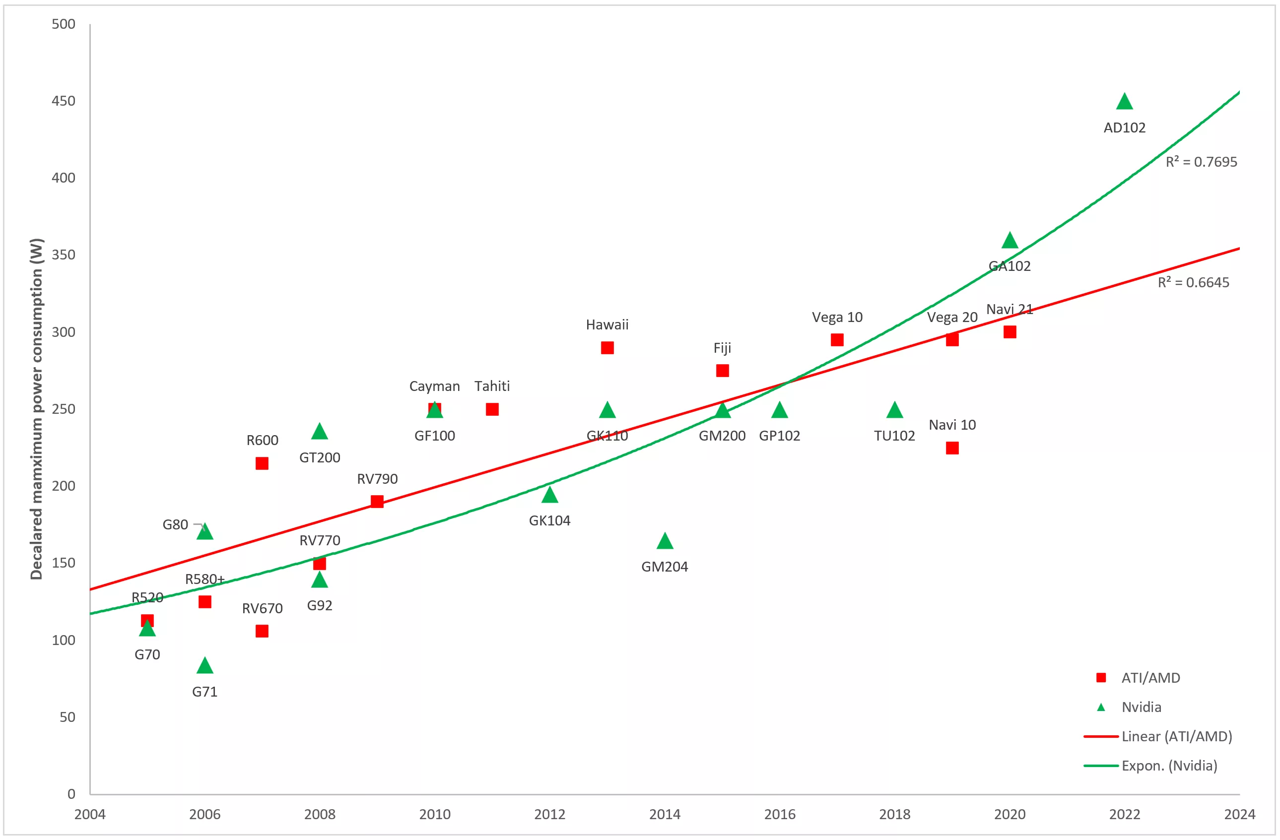
Power Intensity of GPUs
GPU Power demand, has grown by 350%
Projected power consumption of H100 might reach up to 600W
Declared Maximum Power Consumption
Source : Radosvet Desislavov, Fernando Martínez-Plumed, José Hernández-Orallo, https://doi.org/10.1016/j.suscom.2023.100857
Trends in AI inference energy consumption: Beyond the performance-vs-parameter laws of deep learning,
Notes:
Notes:
Since its advent, power demand of GPUs has risen by 350% as represent a recent study. As shown by the timeline plot, the GPU architectures progressed, power consumption for Nvidia GPUs has risen by 350% for the latest ada lovelace architecture class GPUs, which represents an exponential growth. Projected power consumption for NVIDIA’s latest model H100, GPUs is as high as 600 W.
Comments:
Increase text size. Please see Deb's first few slides. First few slides should have few bullets with large text, and very easy on the eyes. This slides has too much info.
Add axis labels to the plot
Changelogs:
Added Source Increased Font Size
Removed 2 bullet points

Slide 3
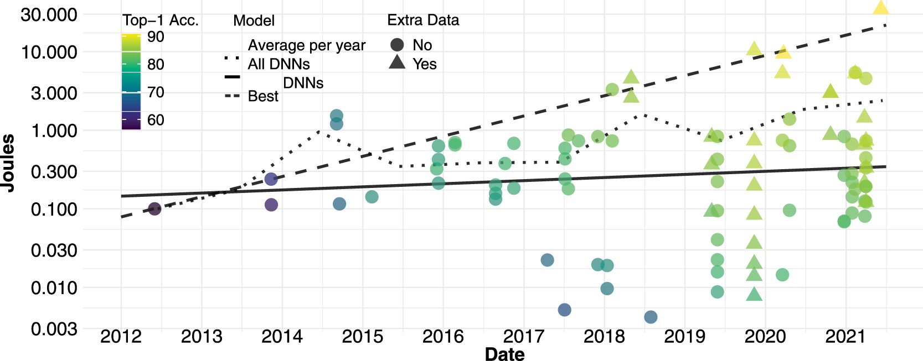
Power Intensity of DNN models
Model Complexity increasing exponentially
Energy Cost per inference increased from 0.1J in 2014 to 30J in 2022
Necessitates optimal deployment of DNN model to reduce energy consumption
Source : Radosvet Desislavov, Fernando Martínez-Plumed, José Hernández-Orallo, https://doi.org/10.1016/j.suscom.2023.100857
Trends in AI inference energy consumption: Beyond the performance-vs-parameter laws of deep learning,
Notes:
Notes:
On another front, the complexity of Deep Neural Network or DNN models are also on the rise. The same study finds that in our quest to find more accurate DNN models, the energy cost of doing a single forward pass has grown considerably. If we refer to the dashed line in timeline plot in the slide, where the points along the dashed line represent the energy consumed for a single inference for the most accurate image classification model for that year, the energy cost of a single inference tested on a V100 GPU for every year since 2012 has risen from 0.1J to 30J. The rapid growth in energy demands for DNN computation necessitates research into understanding optimal deployment of DNN models for energy efficient inference.
Comments:
Same thing, too much info.
Don’t cover the dashed lines (try)
Changelog: Removed 2 bullet points moved the graph down

Slide 4
DNN deployment on edge devices
Benefits:
Decentralized Data Processing
Enhanced Privacy and Security
Challenges:
Resource and Power Constraints
Deployed in resource scarce environments
Several knobs (both hardware and workload) exist that impact energy and performance
Notes:
Notes:
For our research we look into optimal deployment of DNN models in edge devices. Edge devices are small, decentralized computing devices, with or without onboard GPUs, located close to the data source, enabling real-time processing and reducing latency in IoT and network applications. They have several benefits, few of them being Decentralized data processing where data processing is closer to the data source, reducing latency and bandwidth usage. This is crucial for real-time applications like autonomous vehicles and smart city infrastructure. AND Enhanced Privacy and Security: As By processing data locally, Sensitive information can be processed in site, reducing the risk associated with transmitting data over networks to central servers. However, there are many challenges in optimal deployment of DNN inference on edge. Edge devices are often resource constrained and themselves are deployed in resource scarce environments such as on battery or solar power. Furthermore most devices provide multiple hardware and workload knobs such as CPU and GPU frequency that impact energy and performance which involves searching a large parameter space for finding the optimum.
Comments:
Move the figures the device specification slide
Several knobs but exist that impact energy and performance (in Challenges)
Changelogs:
Added third point mentioning knobs in challenges
Increased Font size
Removed Figures and added them to the specifications slide
Notes:
Decentralized Data Processing: Edge computing shifts data processing closer to the data source, reducing latency and bandwidth usage compared to centralized cloud computing. This is crucial for real-time applications like autonomous vehicles and smart city infrastructure.
Enhanced Privacy and Security: By processing data locally, edge devices can improve data privacy and security. Sensitive information can be processed in situ, reducing the risk associated with transmitting data over networks to central servers.
Efficient Deployment of deep learning models on edge devices is challenging primarily because edge devices are themselves resource constrained and they are generally battery operated and deployed in resource scarce environments. Furthermore the NVIDIA suite of edge devices have a large parameter space in terms of CPU and GPU frequency that can be tuned which complicates the problem of finding the energy optimal configuration. As such practitioners often rely on using existing tools such as DVFS and often settle for suboptimal energy savings.

Slide 5
Challenges of energy-optimal DNN deployments on edge
Two hardware knobs that we consider for our analysis are CPU/GPU frequency
Naively adjusting operating CPU/GPU frequency may be sub-optimal
Large parameter space in terms of operating CPU/GPU frequency
Each DNN architecture needs to be studied separately due to varying complexity
 | Jetson Nano | Xavier NX | Orin NX
CPU Frequency (Steps) | 15 | 25 | 26
GPU Frequency (Steps) | 12 | 15 | 7
Total Configurations | 180 | 375 | 182
Notes:
Notes:
As mentioned before Two such knobs as CPU and GPU frequency. However, naively adjusting CPU/GPU frequency may be sub-optimal from energy point-of-view as these knobs can be adjusted but at the cost of power or latency. Also, for the three edge devices that we evaluate for our work – Jetson Nano, Xavier NX and Orins, each of them provide 180, 375 and 182 configurations of CPU and GPU frequencies respectively. While These relatively large parameter spaces providing high granularity and control for power and hence energy adjustments, searching these parameter spaces is not trivial. Further, each DNN architecture, due to varying nature of computational complexity needs to be evaluated separately on each of the edge devices to find the optimal deployment configuration
Comments:
One knob we consider is freq.
CPU GPU frequency can be adjusted but at the cost of power or latency
Replace graph with table
Try to keep slide title location and format consistent across slides.
"needs to be studied separately"
5 bullets is a bit much
for opening slides. You do not need to do death-by-information to get your point across. Keep it to few, prominent points.
Changelogs:
Removed Graph and substituted it with the table
Increased font size
Notes: Elaborating on the challenges pertaining to hardware knobs

Slide 6
Evaluation of Device and Workload parameters
We evaluate 6 Deep Neural Network (DNN) inference workloads (covering Image Classification, Object Detection, and Natural Language) on 3 edge devices (Jetson Nano, Xavier NX and Orin NX)
Hardware Parameters (‘knobs’) include:
CPU Frequency
GPU Frequency
Workload parameters include:
Batch-Sizes
Model Initialization
Notes:
Notes:
For our work we evaluate 6 DNN inference workloads (covering 3 usecases of Image Classification, Object detection, and Natural Language on 3 edge devices Jetson Nano, Xavier NX and Orin NX. For finding out the optimal deployment configuration the hardware parameters that we consider are CPU and GPU frequency and the workload parameters we consider are batch sizes and model initialization
Move the research goals text to a new slide title “Research Goals)
Too much text. You can split into 2 slides if needed with Research Goals in one slide. Also mention somewhere that you have a paper at IGSC on this already.
Move research goals into a own slide
Changelogs:

Slide 7
Research Goals
We aim to understand how hardware and workload parameters influence energy consumption during DNN inference on the 3 Jetson class edge devices
A key objective of our study is to examine whether we can surpass the energy efficiency achieved by default device heuristics in DNN inference on edge devices
Work published as part of proceedings at International Green and Sustainable Computing Conference, 2023 https://doi.org/10.1145/3634769.3634809
Notes:
Our broad research goals are:
We aim to understand how these hardware and workload parameters influence energy consumption during DNN inference on these 3 edge devices
Another key objective of our study is to examine whether we can surpass the energy efficiency achieved by default device heuristics during DNN inference on edge devices by doing a full sweep of all supported CPU/GPU frequencies
(click) These work was recently published as part of proceedings at International Green and Sustainable Computing Conference, 2023
Changelogs:
Added a new research goals slide

Slide 8
Outline
Background & Prior Work
Experimental Setup
Conclusion & Future Work
Experimental Setup
Notes:
Notes:
The Rest of RPE is divided into 4 main sections. (click)
Changelogs:
Added a new research goals slide

Slide 9
Outline
Background & Prior Work
Experimental Setup
Evaluation & Results
Conclusion & Future Work
Notes:
Notes:
Background & Prior Work (click)
Changelogs:
Added a new research goals slide

Slide 10
Outline
Experimental Setup
Background & Prior Work
Evaluation & Results
Conclusion & Future Work
Notes:
Notes:
Experimental Setup (click)
Changelogs:
Added a new research goals slide

Slide 11
Outline
Background & Prior Work
Experimental Setup
Conclusion & Future Work
Evaluation & Results
Notes:
Notes:
Evaluation & Results (click)
Changelogs:
Added a new research goals slide

Slide 12
Outline
Conclusion & Future Work
Background & Prior Work
Experimental Setup
Evaluation & Results
Notes:
Notes:
Conclusion and Future Work (click)
Changelogs:
Added a new research goals slide

Slide 13
Outline
Background & Prior Work
Experimental Setup
Evaluation & Results
Conclusion & Future Work
Notes:
Notes:
Starting with background and prior work (click)
Changelogs:
Added a new research goals slide

Slide 14
Outline
Background & Prior Work
Experimental Setup
Evaluation & Results
Conclusion & Future Work
Device Specifications & DVFS Baselines
Studies on Energy Consumption for DNN Inference
Studies on Energy Consumption for DNN Training
Notes:
Notes: Firstly we discuss the broad tech specs of the 3 edge devices. Followed by relevant literature review of energy consumption studies for DNN workloads for inference and training, on both edge devices and servers. Finally we also discuss a few relevant papers on power and performance investigations on edge devices. In interest of time, we only discuss a the most relevant works here and attach the complete literature survey in the main report.
Changelogs:
Added a new research goals slide

Slide 15
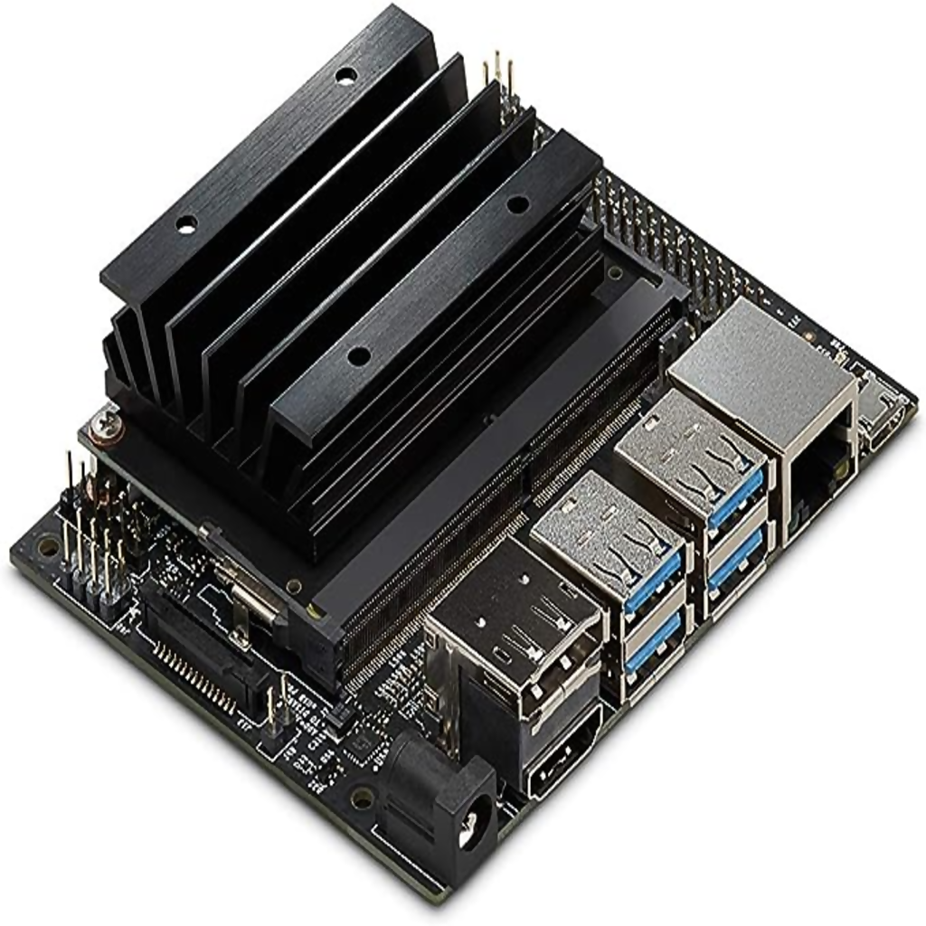
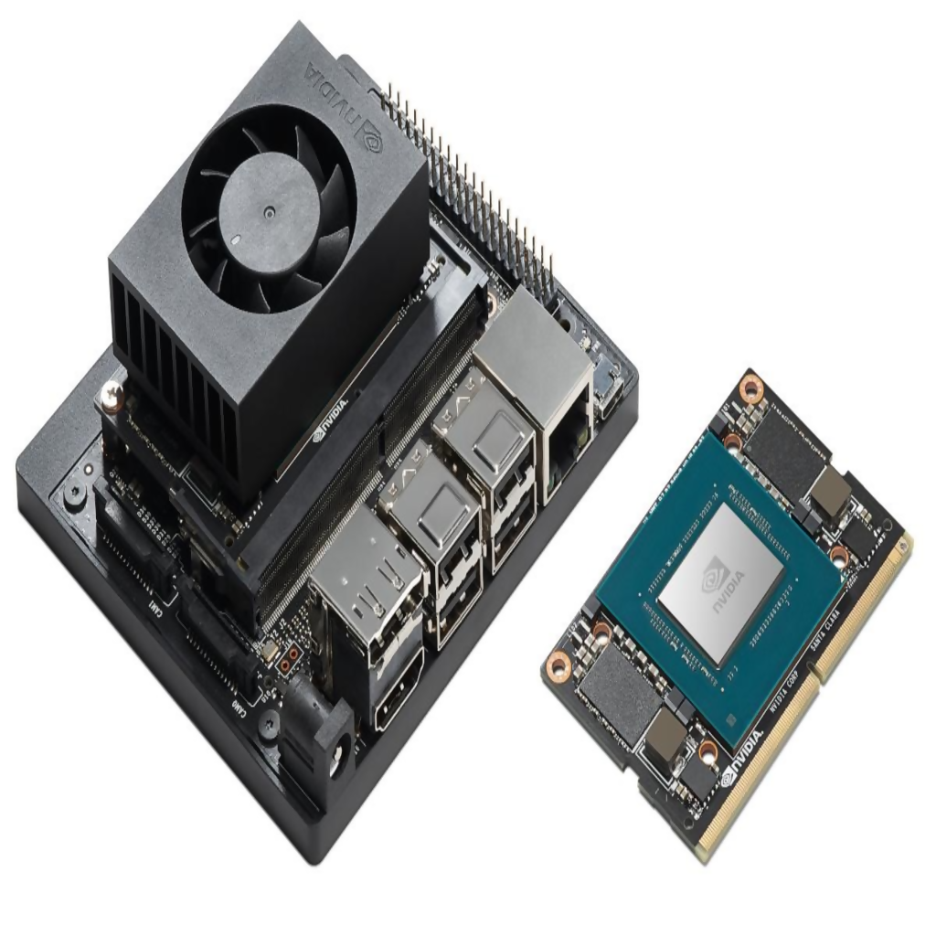
Edge-Device Specifications
Specification | Jetson Nano | Jetson Xavier NX | Jetson Orin NX
CPU | 4-core ARM A57 | 8-core Nvidia Carmel | 8-core Nvidia Cortex
CPU Freq. range | 102 MHz – 1.48 GHz | 115 MHz – 1.9 GHz | 115 MHz – 2.0 GHz
CPU Freq. step | 100 MHz (15 steps) | 77 MHz (25 steps) | 77 MHz (26 steps)
GPU | Nvidia Maxwell | NVIDIA Volta | NVIDIA Ampere
CUDA Cores | 128 | 384 | 1024
Tensor Cores | - | 48 | 32
Memory | 4 GB LPDDR4 | 8 GB LPDDR4 | 16GB LPDDR5
GPU Freq. range | 76 MHz – 921 MHz | 114 MHz – 1.1 GHz | 308 MHz – 918 MHz
GPU Freq. steps | 77 MHz (12 steps) | 90 MHz (15 steps) | 102 MHz (7 steps)
Throughput | 0.472 TOPs | 21 TOPs | 100 TOPs
Notes:
Notes:
The broad tech specs for the 3 jetson class system-on-module devices are mentioned in the table as follows. The table is organized from left to right in ascending order of release chronology and compute capability, with Jetson Nano positioned on the left as the entry-level device and Orin NX on the right as the highest-tier option. (click)
Comments:
System-on-module
Add the figures here
Changelog:
Changed count to steps
Changed flops to tops
Added edge device figures

Slide 16
Edge-Device Specifications
Specification | Jetson Nano | Jetson Xavier NX | Jetson Orin NX
CPU | 4-core ARM A57 | 8-core Nvidia Carmel | 8-core Nvidia Cortex
CPU Freq. range | 102 MHz – 1.48 GHz | 115 MHz – 1.9 GHz | 115 MHz – 2.0 GHz
CPU Freq. step | 100 MHz (15 steps) | 77 MHz (25 steps) | 77 MHz (26 steps)
GPU | Nvidia Maxwell | NVIDIA Volta | NVIDIA Ampere
CUDA Cores | 128 | 384 | 1024
Tensor Cores | - | 48 | 32
Memory | 4 GB LPDDR4 | 8 GB LPDDR4 | 16GB LPDDR5
GPU Freq. range | 76 MHz – 921 MHz | 114 MHz – 1.1 GHz | 308 MHz – 918 MHz
GPU Freq. steps | 77 MHz (12 steps) | 90 MHz (15 steps) | 102 MHz (7 steps)
Throughput | 0.472 TOPs | 21 TOPs | 100 TOPs
Notes:
Notes: In our research, the key specifications demanding our attention are the CPU and GPU frequencies, as well as the number of supported increments. For the Jetson Nano, featuring a Maxwell architecture GPU, it offers 15 CPU alongside 12 GPU frequencies. Moving up to the Xavier NX, equipped with a Volta architecture, it offers 25 CPU frequencies, providing more versatility in performance. Furthermore, it also provides 15 GPU frequencies, adding to its computational adaptability.
The Orin NX with its Ampere architecture supports 26 CPU frequencies spanning for more demanding computational needs. While the Orin NX offers fewer GPU frequencies at 7, they still provide a substantial range from 308 MHz to 918 MHz.
System-on-module
Make the highlight as gradients
Add the figures here
Changelogs: removed the insignificant specs
Added figures here
Changed count to steps

Slide 17
Need for CPU and GPU frequency & DVFS
High-frequencies are required for rapid real-time operations
However, high power leads to high energy consumption
Lower frequencies, are suitable for low power environments
However, increased inference time leads to high energy consumption
DVFS provides predefined heuristics (governors) for dynamic runtime adjustments to CPU/GPU frequency, based on workload demands
Comparison baselines based on Dynamic Voltage and Frequency Scaling
Default CPU governor : ‘Schedutil’
Default GPU governor : ‘Nvhost_Podgov’
Notes:
Notes:
The range of frequencies supported by the edge devices enables multiple runtime scenarios. Higher frequencies enable rapid real-time operations but increase energy consumption, while lower frequencies suit low-power scenarios but can lead to longer processing times, also increasing energy use. At this stage it is important talk about Dynamic Voltage and Frequency Scaling or DVFS. DVFS is a power management technique in computer architecture where the voltage and frequency of a processor are adjusted dynamically based on workload demands to balance power consumption with performance. DVFS governors are predefined heuristics that manage these runtime adjustments to optimize for power efficiency or computational speed as needed. Commonly used CPU DVFS governors are schedutil, performance, powersave and Ondemand. Commonly used GPU DVFS governors for nvidia GPUs are nvhost and wmark.
Although we do measure the energy consumption of our DNN workload for all governors, to represent our baselines we use schedutil for CPU and nvhost for GPU. Scheutil is characterized by dynamic adjustments CPU frequency based on real-time CPU load information from the scheduler, balancing performance and power efficiency. Nvhost is a DVFS governor native to NVIDIA’s Tegra processors that dynamically adjusts the GPU’s voltage and frequency based on workload and thermal conditions.
Maybe needed:
Common DVFS governor policies for optimizing CPU performance are:
Performance Governor: Always runs the processor at its maximum frequency to deliver the highest performance, disregarding energy savings.
Powersave Governor: Operates the processor at the minimum frequency to prioritize energy efficiency over performance .
Ondemand Governor: Scales the CPU frequency dynamically according to current usage. It boosts the frequency to the maximum when the system is busy and reduces it when the load is light [9].
Conservative Governor: Similar to demand but more gradual in changing frequencies. It slowly ramps up the CPU frequency to avoid rapid spikes in power usage [8].
Schedutil Governor: Dynamically adjusts CPU frequency based on real-time CPU load information from the scheduler, balancing performance and power efficiency. Can make both reactive and proactive adjustments [67]. Common DVFS governor policies for optimizing GPU performance (for NVIDIA GPUs) are:
nvhost_podgov: DVFS governor native to NVIDIA’s Tegra processors dynamically adjusts the GPU’s voltage and frequency based on workload and thermal conditions, optimizing for power efficiency and performance while preventing overheating [2, 15].
2. wmark_active DVFS governor is designed to adjust the voltage and frequency of a processor based on active workload thresholds, specifically watermarks (high and low marks). It increases the frequency when the workload exceeds a high watermark, indicating a high demand for processing power, and reduces the frequency when the workload falls below a low watermark, signifying lower processing demands [54]. We encounter ‘Ondemand’ and ‘Conservative’ governor policies for GPUs as well.
Introduce DVFS here (remove governor names)
Changelogs: Added DVFS description here Removed governor names

Slide 18
Prior Works
We classify our literature review in two broad categories:
Energy-efficiency studies for DNN Inference on edge devices
Energy-efficiency studies for DNN training on edge devices/servers
Other orthogonal but related works on DNN inference/training, edge deployments and energy-efficiency/performance/power discussed in the main report
Notes:
Notes: Moving on to literature survey
The literature review is organized into three main categories focused on the energy efficiency of DNN inference operations on edge devices. This is also the category our RPE belongs to. We also discuss works studying energy-efficient practices for DNN training on both servers and edge. Additional related studies on DNN operations and energy, power, and performance optimization in edge computing and servers are covered in the main report.
Changelogs:
Added an additional slide on types of prior works being discussed in the presentation

Slide 19
(1) Prior Work on Energy Consumption for DNN Inference on edge
Holly et al (IGSC 2020).
Key findings include energy-efficiency gains MobileNet-V2 by tuning CPU/GPU frequency on for Jetson Nano
Our work extends this to 3 image classification models, real-time object detection, and 2 Transformer-based language models, on 3 edge devices
Boroumand et al (PACT 2021).
Benchmark the performance of DNN inference execution on a Google TPU, including per-layer energy measurements
Work limited to Google TPUs and CNN models and, relies on DVFS for frequency scaling
Molom-Ochir et al (URTC 2021).
Energy measurement and Throughput comparison of DNN inference several embedded and desktop GPUs,
Relies on Dynamic Voltage and Frequency Scaling (DVFS) for all experiments without individually examining the impact of batch size, CPU, and GPU frequency
Notes:
Notes:
For our first category Prior Work on Energy Consumption for DNN Inference on edge this slide presents summaries from three studies: Holly et al. (IGSC 2020) highlights energy efficiency improvements in MobileNet-V2 by adjusting CPU/GPU frequencies. Boroumand et al. (PACT 2021) benchmark DNN inference on Google TPUs, focusing on CNN models. Molom-Ochir et al. (URTC 2021) compare energy and throughput across multiple embedded and workstation GPUs for DNN inference.
While Holly et al is closest to our work, we extend the results of the paper to include 6 DNN workloads on 3 edge devices and also study workload parameters such as batch size and mode initialization.
The next 2 two works use DVFS for frequency scaling without individually examining the impact of hardware and workload parameters.
Comment:
May be good to first have a simple slide titled Prior Work which just contains the categories of prior works you will discuss or that exist in general: edge/server; training/inference; energy/performance. Then you can highlight where your RPE belongs and which categories you will discuss in this ppt and which you won't (but are in report).
Changelogs: Tried to reduce text as much as possible
Highlighted the main contributions of the paper
Highlighted the main category of the study in header
Added conference names and framework name wherever applicable

Slide 20
(1) Prior Work on Energy Consumption for DNN Inference on edge
Jedi - Jeong et al. (TECS 2021)
Proposes energy-efficient model placement framework considering multi-threading, pipelining, buffer assignment, and network duplication
Focus is on developing optimal model scheduling and placement strategy to utilize heterogeneous resources for inference
Ghasemi et al (SMARTCOMP 2021).
Investigates energy-efficient model partitioning for DNN inference on a server-edge federated setup
Emphasizes energy benefits of server-edge offloading, which is is distinct from end-to-end inference on single devices
Hanafy et al (e-Energy 2021).
Analysis of the energy efficiency and performance for 6 deep neural network (DNN) inference on Jetson Nanos
Only impact of GPU frequency studied and not generalizable to other GPU-based edge devices such as Xavier NXs and Orins
Notes:
Notes:
Jedi and Ghasemi et. Al. investigate orthogonal mathematical optimization frameworks for energy efficient edge deployment by studying energy-efficient model scheduling and placement, and server-edge inference offloading. Hanafy et al analyse energy profiles of multiple DNN models on Nanos. However the models are primarily CNNs and only impact of GPU frequency is studied.
Comments:
May be good to first have a simple slide titled Prior Work which just contains the categories of prior works you will discuss or that exist in general: edge/server; training/inference; energy/performance. Then you can highlight where your RPE belongs and which categories you will discuss in this ppt and which you won't (but are in report).
Changelogs: Tried to reduce text as much as possible
Highlighted the main contributions of the paper
Highlighted the main category of the study in header
Added conference names and framework name wherever applicable

Slide 21
(1) Prior Work on Energy Consumption for DNN Inference on edge
Study | Frequency Scaling | Inference-Workload | Workload-Parameter adjustment | Hardware
Holly et. al | Full Sweep, Cores | 1 (Image Classification) | No | Jetson Nano
Boroumand et. al | DVFS | 6 (Image Classification) | Yes | Google TPU
Molom-Ochir et. al | DVFS | 3 (Image Classification) 2(Natural Language) | No | Multiple SoCs and workstations
Ghasemi et. al | DVFS | 1 (Object Detection) | No | Edge-Cloudlet offloading
Jeong et. al | DVFS (Focus on model placement) | 4 (Object Detection) | No | Jetson Nano, Xavier NX
Hanafy et. al | GPU Frequency | 6 (Image Classification) | No | Jetson Nano, GTX 1660
Our work | Full Sweep | 3 (Image Classification) 1 (Object Detection) 2 (Natural Language) | Yes | Jetson Nano, Xavier NX, Orin NX
Notes:
Summarizing all the prior works investigating energy efficient DNN inference deployments on edge (click)

Slide 22
(1) Prior Work on Energy Consumption for DNN Inference on edge
Study | Frequency Scaling | Inference-Workload | Workload-Parameter adjustment | Hardware
Holly et. al | Full Sweep, Cores | 1 (Image Classification) | No | Jetson Nano
Boroumand et. al | DVFS | 6 (Image Classification) | Yes | Google TPU
Molom-Ochir et. al | DVFS | 3 (Image Classification) 2(Natural Language) | No | Multiple SoCs and workstations
Ghasemi et. al | DVFS | 1 (Object Detection) | No | Edge-Cloudlet offloading
Jeong et. al | DVFS (Focus on model placement) | 4 (Object Detection) | No | Jetson Nano, Xavier NX
Hanafy et. al | GPU Frequency | 6 (Image Classification) | No | Jetson Nano, GTX 1660
Our work | Full Sweep | 3 (Image Classification) 1 (Object Detection) 2 (Natural Language) | Yes | Jetson Nano, Xavier NX, Orin NX
Notes:
Our work tries to fill the gap in the literature for finding energy-efficient DNN inference workload deployments on edge, by performing a full-sweep of CPU-GPU frequency range for 6 DNN models spread across 3 usecases across 3 edge devices. We also consider the joint impact of workload parameters such as batch size on energy measurements which us notably missing from the literature, to the best of our knowledge.

Slide 23
(2) Prior Work on Energy Consumption for DNN Training
Zeus - You et al. (NSDI 2023)
Focuses on the energy efficient training of DNNs by intelligently tuning GPU-frequency and batch-size
Research is centered on optimizing energy consumption for deep neural network (DNN) training primarily on server-grade GPUs.
Prashanthi et al. (POMACS 2022)
Analysis of the performance of DL training on NVIDIA Jetson devices (AGX Xavier, Xavier NX, and Nano) by optimizing hardware resources like CPU cores, storage media, and power modes
Results provide insights into edge device specifications factors impact training time, energy usage, and performance
Notes:
Notes:
Moving to works studying energy consumption for DNN training: Zeus (NSDI 2023) explores energy-efficient DNN training by adjusting GPU frequency and batch size. However the work focuses on server-grade GPUs and DNN training. Prashanthi et al. (POMACS 2022) study DL training on NVIDIA Jetson devices, examining how the tuning of CPU cores, storage media, and power modes can affect training time, energy consumption, and performance. These studies contribute to understanding and improving the energy efficiency of DNN training on both server and edge devices.
Mention system names/framework names
Notes:
Mention other works include system optimization

Slide 24
(2) Prior Work on Energy Consumption for DNN Training
Differentiation between DNN training and DNN inference is crucial
Energy demands and optimization strategies can significantly differ between the training and inference stages
Training involves processing large datasets to build the model and is often compute-intensive (due to backpropagation). Sensitive to memory, network-delays and parallelization.
Inference requires less computational power but often needs to be highly efficient, especially in real-time or edge computing scenarios. Sensitive to latency.
Key Takeaway:
Energy optimization strategies for deep learning training cannot be directly transferred to deep learning inference due to their fundamental differences
Notes:
Notes:
However, distinguishing between DNN training and inference is essential due to their differing energy demands and optimization strategies. Training is computationally intensive, involving large datasets and backpropagation, where memory bandwidth, network delays, and the ability to parallelize tasks are critical factors. In contrast, inference is less computationally demanding but requires high efficiency and low latency, particularly for real-time applications or edge computing environments. Hence a key takeaway is Energy optimization strategies for deep learning training cannot be directly transferred to deep learning inference due to their fundamental differences

Slide 25
Outline
Background & Prior Work
Experimental Setup
Evaluation & Results
Conclusion & Future Work
Notes:
Notes:
That was a brief overview of relevant prior works as well as the position of our research in the literature (click)
Changelogs:
Added a new research goals slide

Slide 26
Outline
Experimental Setup
Background & Prior Work
Evaluation & Results
Conclusion & Future Work
Notes:
Notes:
Now we move on to experimental setup where (click)
Changelogs:
Added a new research goals slide

Slide 27
Outline
Experimental Setup
Background & Prior Work
Evaluation & Results
Conclusion & Future Work
Experimental Setup
DNN Workloads
Hardware Knobs
Notes:
Notes:
Primarily discuss, our energy profiling framework, the workloads that we profile and the hardware knobs that we optimize as a part of our work
Changelogs:
Added a new research goals slide

Slide 28
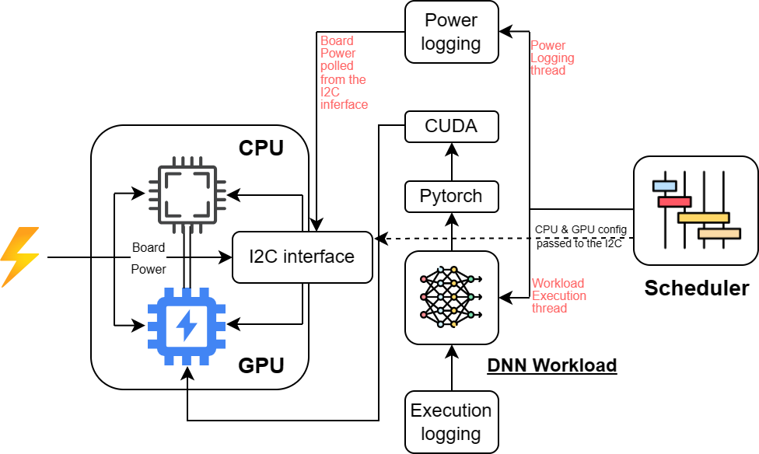
Experimental Setup
Power readings for each edge device are polled at 100ms intervals (Overhead < 0.5%)
I2C interface is polled in a separate thread for more granular readings, Static CPU/GPU freqs set through I2C interface as well​
PyTorch for all the workloads except for YOLOv4 (OpenCV)
Fixed workload - 3200 inferences inputs (10 reruns; variance was less than 5%​)
Full-sweep of all workloads was conducted for all supported CPU and GPU frequencies
Notes:
The slide details our framework for energy profiling. Our power readings are taken at 100ms intervals to ensure that the profiling overhead consumes less than 0.5% of the total board energy. For finer granularity, we build our profiler instead of using existing tools like tegrastats. The I2C interface is polled in a dedicated thread, and CPU/GPU frequencies are statically set through the same I2C interface. PyTorch is employed for all workloads, with the exception of YOLOv4, which uses OpenCV. A fixed workload of 3200 inference inputs is processed for each run, and the runs are repeated 10 times to ensure less than 5% variance between energy values. A full-sweep across all supported CPU and GPU frequencies is conducted to assess workload performance.

Slide 29
Deep Learning Workloads
Model | Task | Params | Batch Size | Input
AlexNet | Image Classification | 61M | 8, 16, 32, 64 | Tensor
ResNet-18 | Image Classification | 11M | 8, 16, 32, 64 | Tensor
MobileNet-V2 | Image Classification | 3.4M | 8, 16, 32, 64 | Tensor
YOLOv4-Tiny | Object Detection | 6.1M | 8, 16, 32, 64 | Tensor
BERT-Tiny | Natural Language | 4.4M | 8, 16, 32, 64 | String
DistilBERT | Natural Language | 43.2 | 8, 16, 32, 64 | String
Notes:
Notes:
Our workloads are divided across three usecases – Image Classification, Object Detection and Natural Language Classification. We evaluate all the workloads for 4 batch sizes 8,16,32 and 64. Xavier and Orins support higher batch sizes than 64 but nanos do not. Hence for the sake of parity we restrict batch size to 64. (click)
Comments:
Fix the task column
Again, try to keep the location of slide titles consistent across slides if possible Add a column for category/task of the model
Changelogs:
Fixed the task column and centered the columns and table
Remove underlines for model column

Slide 30
Deep Learning Workloads
Model | Task | Params | Batch Size | Input
AlexNet | Image Classification | 61M | 8, 16, 32, 64 | Tensor
ResNet-18 | Image Classification | 11M | 8, 16, 32, 64 | Tensor
MobileNet-V2 | Image Classification | 3.4M | 8, 16, 32, 64 | Tensor
YOLOv4-Tiny | Object Detection | 6.1M | 8, 16, 32, 64 | Tensor
BERT-Tiny | Natural Language | 4.4M | 8, 16, 32, 64 | String
DistilBERT | Natural Language | 43.2 | 8, 16, 32, 64 | String
Notes:
Notes:
We use Alexnet, Resnet-18 and mobilenet-v2 for image classification workloads (click)
Comments:
Fix the task column
Again, try to keep the location of slide titles consistent across slides if possible Add a column for category/task of the model
Changelogs:
Fixed the task column and centered the columns and table
Remove underlines for model column

Slide 31
Deep Learning Workloads
Model | Task | Params | Batch Size | Input
AlexNet | Image Classification | 61M | 8, 16, 32, 64 | Tensor
ResNet-18 | Image Classification | 11M | 8, 16, 32, 64 | Tensor
MobileNet-V2 | Image Classification | 3.4M | 8, 16, 32, 64 | Tensor
YOLOv4-Tiny | Object Detection | 6.1M | 8, 16, 32, 64 | Tensor
BERT-Tiny | Natural Language | 4.4M | 8, 16, 32, 64 | String
DistilBERT | Natural Language | 43.2 | 8, 16, 32, 64 | String
Notes:
Notes:
We use Yolov4-tiny for object detection (click)
Comments:
Fix the task column
Again, try to keep the location of slide titles consistent across slides if possible Add a column for category/task of the model
Changelogs:
Fixed the task column and centered the columns and table
Remove underlines for model column

Slide 32
Deep Learning Workloads
Model | Task | Params | Batch Size | Input
AlexNet | Image Classification | 61M | 8, 16, 32, 64 | Tensor
ResNet-18 | Image Classification | 11M | 8, 16, 32, 64 | Tensor
MobileNet-V2 | Image Classification | 3.4M | 8, 16, 32, 64 | Tensor
YOLOv4-Tiny | Object Detection | 6.1M | 8, 16, 32, 64 | Tensor
BERT-Tiny | Natural Language | 4.4M | 8, 16, 32, 64 | String
DistilBERT | Natural Language | 43.2 | 8, 16, 32, 64 | String
Notes:
Notes:
And BERT-tiny and DistilBERT for natural language classification (click)
Comments:
Fix the task column
Again, try to keep the location of slide titles consistent across slides if possible Add a column for category/task of the model
Changelogs:
Fixed the task column and centered the columns and table
Remove underlines for model column

Slide 33
Hardware Knobs
Hardware Parameters (‘knobs’) we study for our work:
CPU Frequency
GPU Frequency
CPU Cores (not evaluated)
CPU Frequency impacts processes not accelerated by GPU which include:
Data Preprocessing and Post-Processing
Model loading and initialization
Data Transfer Operations and Control Flow
GPU Frequency impacts processes all DNN forward pass operations:
Matrix Multiplications and Tensor Operations
Graphical Data Processing
Notes:
Notes: This slide outlines the hardware parameters, or 'knobs’, that we analyze, which include CPU and GPU frequencies; however, impact of CPU cores, although available as a tunable hardware parameter is not evaluated due to the Global Interpreter Lock (GIL) in Python, which restricts execution to a single thread, thereby limiting multi-core utility. CPU frequency predominantly influences non-GPU accelerated processes such as data preprocessing, post-processing, model loading, initialization, and data transfer operations. On the other hand, GPU frequency affects all forward pass operations in deep neural networks, including matrix multiplications, tensor operations, and graphical data processing

Slide 34
Outline
Experimental Setup
Background & Prior Work
Evaluation & Results
Conclusion & Future Work
Notes:
Notes: Moving on from experimental setup (click)
Changelogs:
Added a new research goals slide

Slide 35
Outline
Evaluation & Results
Background & Prior Work
Experimental Setup
Conclusion & Future Work
Notes:
Notes:
We discuss our results for full-sweeps for 4 batch sizes on all 6 workloads (click)
Changelogs:
Added a new research goals slide

Slide 36
Outline
Evaluation & Results
Background & Prior Work
Experimental Setup
Conclusion & Future Work
Jetson Nano – Frequency Sweep, Energy Topology, Impact of Batch Size
Orin NX – Frequency Sweep, Energy Topology, Impact of Batch Size
Impact of Model Initialization & Other Factors
Notes:
Notes:
We start with frequency sweep, energy topology and impact of batch size on energy for Jetson Nanos. For sake of time we omit the results for Xavier NXs, because their similarity to Jetson Nano, however we do mention the broad differences between the 2. Then we discuss the results for Orins followed by results for impact of model initialization and other factors on energy
Changelogs:
Added a new research goals slide

Slide 37
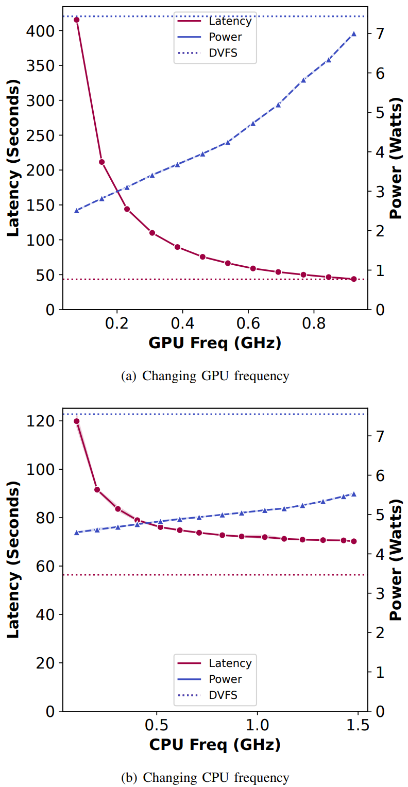
Jetson Nano – Frequency Scaling Sweep
As a sanity check we ensure that power & inference latency are monotonic
DVFS operates at the highest CPU frequency for 89% and at highest GPU frequency for 83% of the total execution
Difference in energy consumption of other DVFS governors is within 1% of default (including ‘Powersave’ which consumes 0.01% more)
Computationally intensive operations offloaded to GPU; resulting in GPU frequency having a higher impact
Notes:
Notes:
The double y-axis latency/power plots show the latency and power consumption with increasing GPU and CPU frequency. (click)
Comments:
Mention the plateau effect
Increase the label and tick font size
Changelong
Increased font size of labels and ticks

Slide 38
Jetson Nano – Frequency Scaling Sweep
As a sanity check we ensure that power & inference latency are monotonic
DVFS operates at the highest CPU frequency for 89% and at highest GPU frequency for 83% of the total execution
Difference in energy consumption of other DVFS governors is within 1% of default (including ‘Powersave’ which consumes 0.01% more)
Computationally intensive operations offloaded to GPU; resulting in GPU frequency having a higher impact
Notes:
Notes:
The left y-axis shows inference latency for one alexnet inference workload in seconds (click)
Comments:
Mention the plateau effect
Increase the label and tick font size
Changelong
Increased font size of labels and ticks

Slide 39
Jetson Nano – Frequency Scaling Sweep
As a sanity check we ensure that power & inference latency are monotonic
DVFS operates at the highest CPU frequency for 89% and at highest GPU frequency for 83% of the total execution
Difference in energy consumption of other DVFS governors is within 1% of default (including ‘Powersave’ which consumes 0.01% more)
Computationally intensive operations offloaded to GPU; resulting in GPU frequency having a higher impact
Notes:
Notes:
The right y-axis shows average power consumption during one alexnet inference workload in Watts (click)
Comments:
Mention the plateau effect
Increase the label and tick font size
Changelong
Increased font size of labels and ticks

Slide 40
Jetson Nano – Frequency Scaling Sweep
As a sanity check we ensure that power & inference latency are monotonic
DVFS operates at the highest CPU frequency for 89% and at highest GPU frequency for 83% of the total execution
Difference in energy consumption of other DVFS governors is within 1% of default (including ‘Powersave’ which consumes 0.01% more)
Computationally intensive operations offloaded to GPU; resulting in GPU frequency having a higher impact
Notes:
Notes:
The top is latency and power plot with respect to increasing GPU frequency (click)
Comments:
Mention the plateau effect
Increase the label and tick font size
Changelong
Increased font size of labels and ticks

Slide 41
Jetson Nano – Frequency Scaling Sweep
As a sanity check we ensure that power & inference latency are monotonic
DVFS operates at the highest CPU frequency for 89% and at highest GPU frequency for 83% of the total execution
Difference in energy consumption of other DVFS governors is within 1% of default (including ‘Powersave’ which consumes 0.01% more)
Computationally intensive operations offloaded to GPU; resulting in GPU frequency having a higher impact
Notes:
Notes:
And the bottom plot is with respect to increasing CPU frequency (click)
Comments:
Mention the plateau effect
Increase the label and tick font size
Changelong
Increased font size of labels and ticks

Slide 42
Jetson Nano – Frequency Scaling Sweep
As a sanity check we ensure that power & inference latency are monotonic
DVFS operates at the highest CPU frequency for 89% and at highest GPU frequency for 83% of the total execution
Difference in energy consumption of other DVFS governors is within 1% of default (including ‘Powersave’ which consumes 0.01% more)
Computationally intensive operations offloaded to GPU; resulting in GPU frequency having a higher impact
Notes:
Notes:
The maroon reddish line represents the change in inference latency with respect to increase in GPU and CPU frequency (click)
Comments:
Mention the plateau effect
Increase the label and tick font size
Changelong
Increased font size of labels and ticks

Slide 43
Jetson Nano – Frequency Scaling Sweep
As a sanity check we ensure that power & inference latency are monotonic
DVFS operates at the highest CPU frequency for 89% and at highest GPU frequency for 83% of the total execution
Difference in energy consumption of other DVFS governors is within 1% of default (including ‘Powersave’ which consumes 0.01% more)
Computationally intensive operations offloaded to GPU; resulting in GPU frequency having a higher impact
Notes:
Notes:
The dotted maroon reddish straight line is the latency baseline with DVFS (click)
Comments:
Mention the plateau effect
Increase the label and tick font size
Changelong
Increased font size of labels and ticks

Slide 44
Jetson Nano – Frequency Scaling Sweep
As a sanity check we ensure that power & inference latency are monotonic
DVFS operates at the highest CPU frequency for 89% and at highest GPU frequency for 83% of the total execution
Difference in energy consumption of other DVFS governors is within 1% of default (including ‘Powersave’ which consumes 0.01% more)
Computationally intensive operations offloaded to GPU; resulting in GPU frequency having a higher impact
Notes:
Notes:
The blue line represents the change in power with respect to increase in GPU and CPU frequency (click)
Comments:
Mention the plateau effect
Increase the label and tick font size
Changelong
Increased font size of labels and ticks

Slide 45
Jetson Nano – Frequency Scaling Sweep
As a sanity check we ensure that power & inference latency are monotonic
DVFS operates at the highest CPU frequency for 89% and at highest GPU frequency for 83% of the total execution
Difference in energy consumption of other DVFS governors is within 1% of default (including ‘Powersave’ which consumes 0.01% more)
Computationally intensive operations offloaded to GPU; resulting in GPU frequency having a higher impact
Notes:
Notes:
The dotted blue straight line is the power baseline with DVFS (click)
Comments:
Mention the plateau effect
Increase the label and tick font size
Changelong
Increased font size of labels and ticks

Slide 46
Jetson Nano – Frequency Scaling Sweep
As a sanity check we ensure that power & inference latency are monotonic
DVFS operates at the highest CPU frequency for 89% and at highest GPU frequency for 83% of the total execution
Difference in energy consumption of other DVFS governors is within 1% of default (including ‘Powersave’ which consumes 0.01% more)
Computationally intensive operations offloaded to GPU; resulting in GPU frequency having a higher impact
Key Takeaway:
While GPU frequency significantly impacts both power consumption and inference latency, CPU frequency has a comparatively lesser impact DVFS favors higher frequencies, leading to increased power consumption
Notes:
Notes:
To begin with, we sanity check that power and inference curves are monotonic with increasing GPU and CPU frequency, which is expected behavior. The very high values of DVFS baseline power and low latency tells us that the DVFS is inefficient at optimally scaling frequencies for DNN forward passes. We further observe that DVFS operates at the highest CPU frequency for 89% and at highest GPU frequency for 83% of the total execution. Difference in energy consumption between the default schedutil and nvhost governors and other governors such as ondemand and performance is 1%, which indicates all the other governors are equally sub-optimal at efficient scaling of frequencies. Powersave is also inefficient in significantly saving energy as it naively sets the operating frequency to lowest possible, which although conserves power, drastically increases execution time. Decrease in inference latency starts to plateau out at higher GPU and CPU frequencies as at higher frequency the tensor operations are not bottlenecked by GPU or CPU but by other components such as memory and I/O bandwidth Lastly we also note that, GPU frequencies have an higher impact than CPU frequencies as the plateau effect is observed much later for GPU. This is expected as Computationally intensive operations in a forward pass are offloaded to GPU. (click). Read key takeaways
Comments:
Mention the plateau effect
Increase the label and tick font size
Changelong
Increased font size of labels and ticks

Slide 47
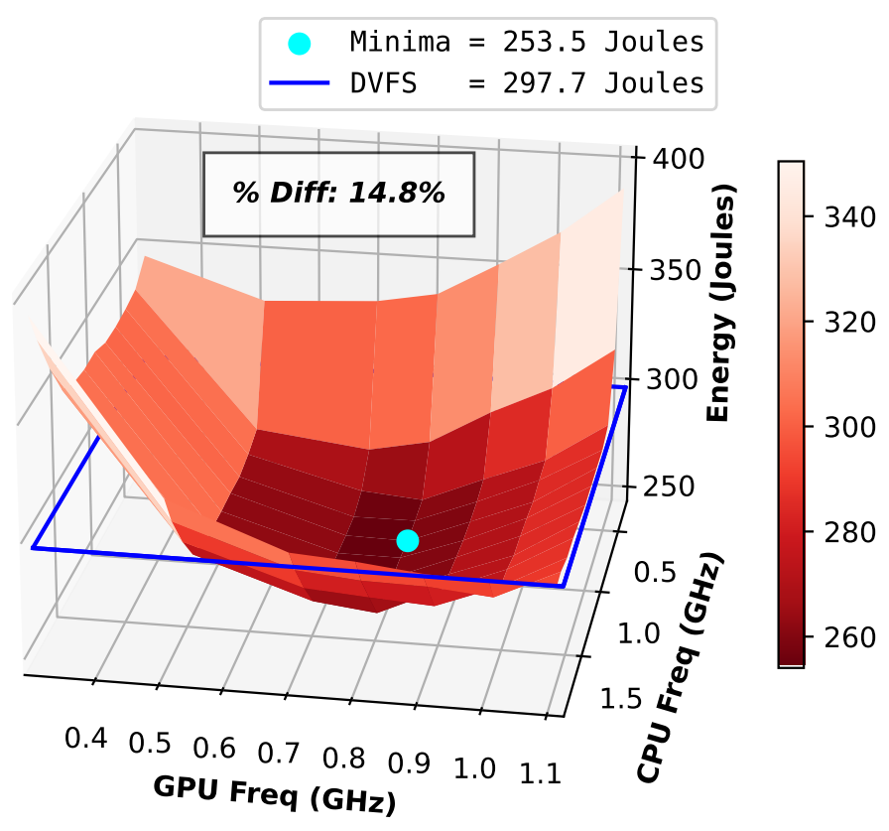
Energy Topology plots
Depicts a heatmap of energy consumption at various CPU/GPU configurations
Blue boundary lines represents the energy consumption by DVFS for the workload
Most efficient energy configuration represented by the scatter dot
‘% Diff’ value represents the difference in energy consumption between DVFS and the most optimal configuration obtained by full-sweep
Notes:
Notes:
Next we move on to energy topology plots. The plots depict a heatmap of energy consumption at various CPU/GPU configurations. (click)
Mention the plateau effect
Increase the label and tick font size
Mention higher difference is better
Changelong
Increased font size of labels and ticks

Slide 48
Energy Topology plots
Depicts a heatmap of energy consumption at various CPU/GPU configurations
Blue boundary lines represents the energy consumption by DVFS for the workload
Most efficient energy configuration represented by the scatter dot
‘% Diff’ value represents the difference in energy consumption between DVFS and the most optimal configuration obtained by full-sweep
Notes:
Notes:
Darker shades of red in the heatmap represent a lower energy consumption and vice versa. (click)
Mention the plateau effect
Increase the label and tick font size
Mention higher difference is better
Changelong
Increased font size of labels and ticks

Slide 49
Energy Topology plots
Depicts a heatmap of energy consumption at various CPU/GPU configurations
Blue boundary lines represents the energy consumption by DVFS for the workload
Most efficient energy configuration represented by the scatter dot
‘% Diff’ value represents the difference in energy consumption between DVFS and the most optimal configuration obtained by full-sweep
Notes:
Notes:
The GPU and CPU frequencies are represented in the X-and Y axes respectively.
Mention the plateau effect
Increase the label and tick font size
Mention higher difference is better
Changelong
Increased font size of labels and ticks

Slide 50
Energy Topology plots
Depicts a heatmap of energy consumption at various CPU/GPU configurations
Blue boundary lines represents the energy consumption by DVFS for the workload
Most efficient energy configuration represented by the scatter dot
‘% Diff’ value represents the difference in energy consumption between DVFS and the most optimal configuration obtained by full-sweep
Notes:
Notes:
The energy measurement for one run of 3200 inferences for the given workload is depicted in the x-axis. (click)
Mention the plateau effect
Increase the label and tick font size
Mention higher difference is better
Changelong
Increased font size of labels and ticks

Slide 51
Energy Topology plots
Depicts a heatmap of energy consumption at various CPU/GPU configurations
Blue boundary lines represents the energy consumption by DVFS for the workload
Most efficient energy configuration represented by the scatter dot
‘% Diff’ value represents the difference in energy consumption between DVFS and the most optimal configuration obtained by full-sweep
Notes:
Notes:
The Blue boundary lines represents the energy consumption by DVFS for the workload. (click)
Mention the plateau effect
Increase the label and tick font size
Mention higher difference is better
Changelong
Increased font size of labels and ticks

Slide 52
Energy Topology plots
Depicts a heatmap of energy consumption at various CPU/GPU configurations
Blue boundary lines represents the energy consumption by DVFS for the workload
Most efficient energy configuration represented by the scatter dot
‘% Diff’ value represents the difference in energy consumption between DVFS and the most optimal configuration obtained by full-sweep
Notes:
Notes:
Most efficient energy configuration represented by the cyan scatter dot. (click)
Mention the plateau effect
Increase the label and tick font size
Mention higher difference is better
Changelong
Increased font size of labels and ticks

Slide 53
Energy Topology plots
Depicts a heatmap of energy consumption at various CPU/GPU configurations
Blue boundary lines represents the energy consumption by DVFS for the workload
Most efficient energy configuration represented by the scatter dot
‘% Diff’ value represents the difference in energy consumption between DVFS and the most optimal configuration obtained by full-sweep
Notes:
Notes:
‘% Diff’ value represents the energy savings between DVFS and the most optimal configuration obtained by full-sweep. (click)
Mention the plateau effect
Increase the label and tick font size
Mention higher difference is better
Changelong
Increased font size of labels and ticks

Slide 54
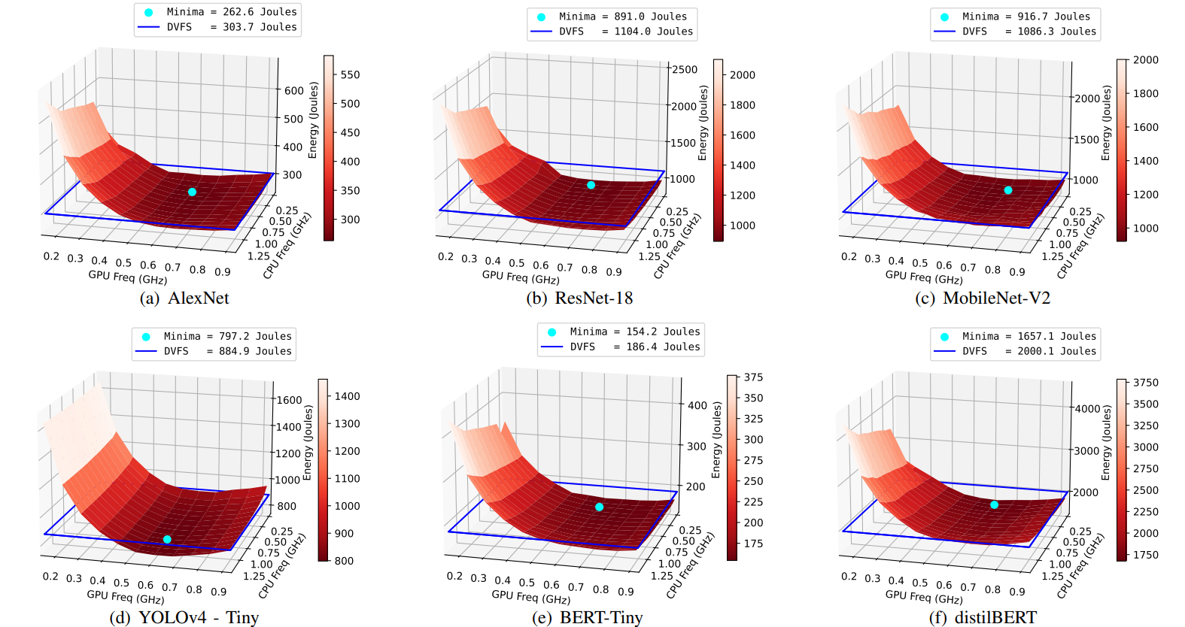
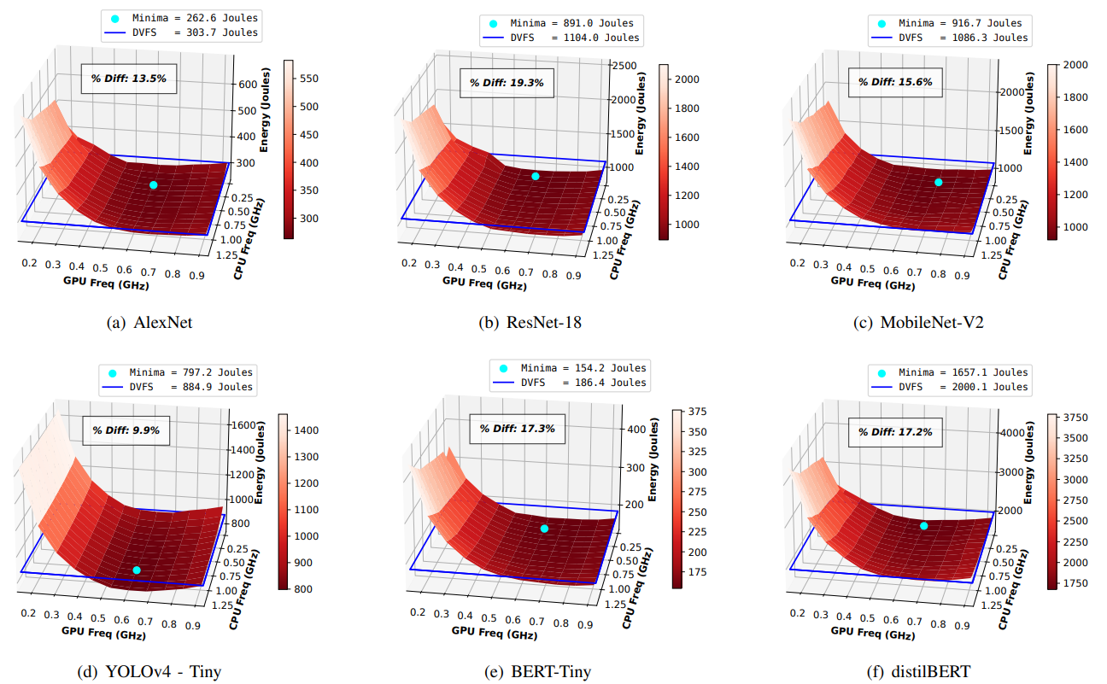
Jetson Nano – Energy Topology
Key Takeaway:
Optimal energy configuration for all 6 DNN workloads on the Jetson Nano is achieved at moderate GPU frequencies, leading to energy savings to the tune of 19% compared to DVFS
Notes:
Notes:
Energy savings between DVFS and optimal energy configuration obtained by full sweep varies between 9.9% and 19.3% for all 6 workloads. Minima is usually achieved at a moderate GPU frequency of 614Mhz. At this stage it needs to noted latency of the most energy-optimal configuration is 28% - 25% higher than DVFS. (click) Read takeaway
Comments:
Energy saved - 13.5%, 19.3%, 15.6%, 9.9%, 17.3%, and 17.2%,
Mention latency trade-offs Put the minima percentages in the plot
Add an extra slide explaining 1 alexnet figure completely

Slide 55
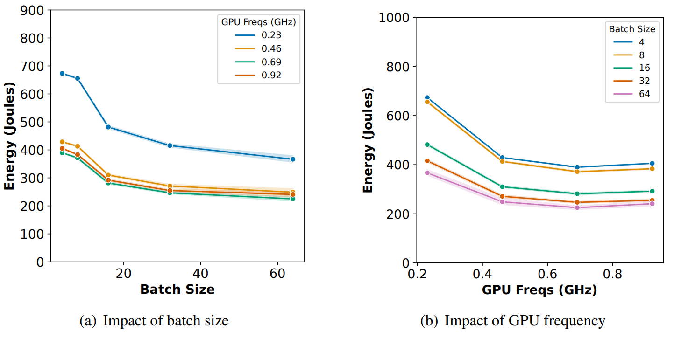
Jetson Nano – Impact of Batch Size
Energy drops almost linearly with batch size
Energy for highest batch-size is almost 40-45% lower than the lowest batch size
Drop is less pronounced at higher batch sizes as GPU throughput saturates for higher batch sizes
Key Takeaway:
Increasing the batch size in AlexNet inference on the Jetson Nano significantly reduces energy consumption, as larger batch sizes decrease the number of mini-batches, thereby reducing GPU I/O and preprocessing activities
Notes:
Notes:
Studying impact of batch on 1 alexnet workload on jetson nano, we find that Energy drops almost linearly with batch size (as seen in the left plot). To better understand the plots, the left plot shows the Energy vs batch numbers with each colored line representing a different GPU frequency. For sake of clarity we represent 4 out of 12 GPU frequencies incrementing at intervals of 0.23 GHz. The right plot shows a different perspective of the left plot Energy vs GPU frequency with each colored line representing a different batch size.
As inferred from the left plot, Energy for highest batch-size is almost 40-45% lower than the lowest batch size all GPU frequencies. (click) Read Key takeaway
The drop in energy consumption is less pronounced at higher batch sizes as GPU throughput saturates for higher batch sizes
Add slide on similarity between xaviers and orin

Slide 56
Similarities between Nano and Xavier results
DVFS behavior in Xavier is similar as in Nanos. DVFS operates at the highest CPU frequency for 87% and at highest GPU frequency for 79% of the total execution
Energy savings for Xaviers vary between 13.42% and 21.95% for all 6 workloads
Joint optimization of execution frequencies and batch size may yield energy savings to the tune of 35 - 42% for Xaviers
Overall trends for Nanos and Xaviers are similarity
Notes:
Note:
For sake of time we omit Xavier results are the trends are very similar to Nanos. Full results are submitted in the report. DVFS behavior in Xavier is similar as in Nanos. DVFS operates at the highest CPU frequency for 87% and at highest GPU frequency for 79% of the total execution. Energy savings for Xaviers vary between 13.42% and 21.95% for all 6 workloads. Joint optimization of execution frequencies and batch size may yield energy savings to the tune of 35 - 42% for Xaviers
Add a takeaway banner
Increase the font size to 18

Slide 57
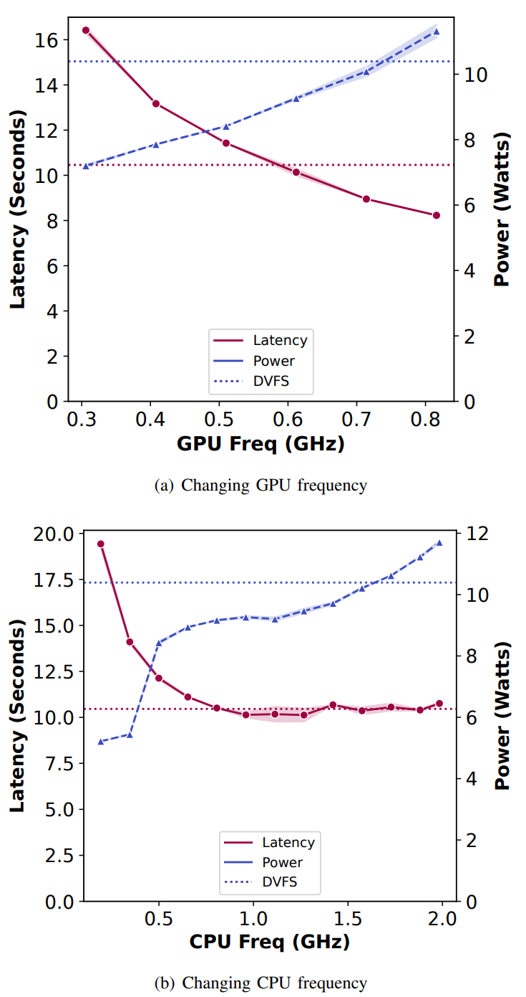
Orin– Frequency Scaling Sweep
DVFS operates at the highest CPU frequency for 56% and at highest GPU frequency for 59% of the total execution
Slightly conservative behavior of DVFS can be attributed to Power-Capping & Thermal Throttling
Difference in energy consumption of other DVFS governors is within 2% of default (including ‘Powersave’ which consumes 1.5% less)
Overall Trends remain similar to Nano and Xavier
Key Takeaway:
Orin NX, leveraging the Ampere architecture, shows a linear increase in power with GPU frequency and a less pronounced latency plateau at high frequencies DVFS in Orin is more conservative due to power capping and thermal throttling compared to the default governors
Notes:
Notes: We discuss Orin separately as Orin being a Ampere Class device is equipped with Power-Capping and Thermal Management modules along with regular DVFS heuristics. Power capping for Ampere GPUs involves setting a maximum limit on the power consumption based on workload. Thermal throttling is another protective measure that automatically reduces the clock speed to prevent overheating when the GPU reaches a certain temperature threshold. DVFS operates at the highest CPU frequency for 56% and at highest GPU frequency for 59% of the total execution for Orins and this conservative behavior can be attributed to power-capping and thermal throttling. However, barring this Overall trends for Orins remain similar to Nanos and Xaviers. Our takeaways from Full sweep of Orins are: (click) read takeaways
Comments:
Mention the plateau effect Explain power capping and thermal throttling in one sentence Change the “within” to among governors

Slide 58
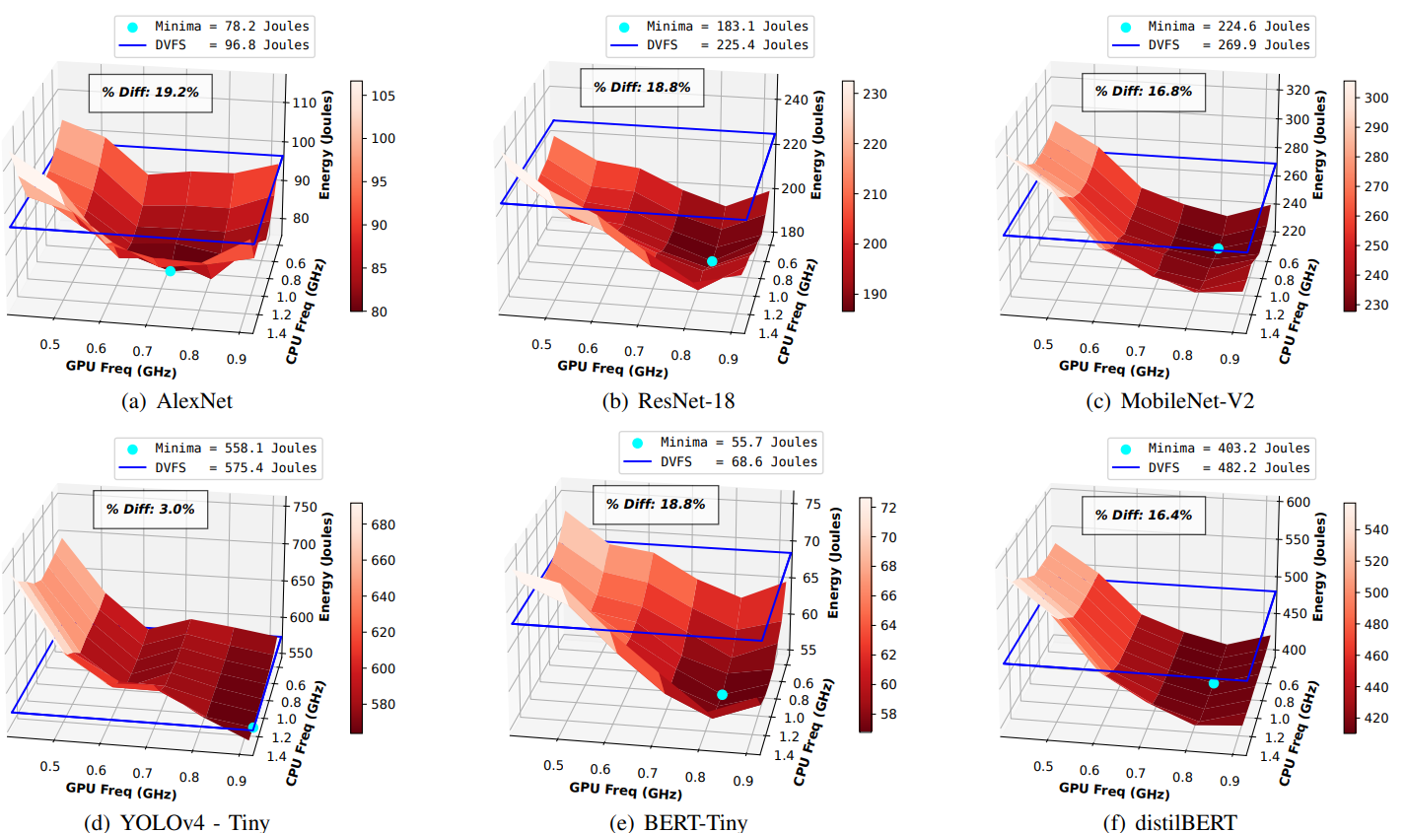
Orin– Energy Topology
Key Takeaway:
Optimizing DVFS for DNN workloads is challenging due to their computational complexity, variable energy demands, and need to balance performance, energy and, thermal constraints
Notes:
Notes:
Energy savings between DVFS and optimal energy configuration obtained by full sweep varies between 3.0% and 19.2% for all 6 workloads. Minima is usually achieved at a moderate GPU frequency of 816Mhz. However, despite added heuristics of power-capping and thermal management, one key takeaway that we observe is :(click) read takeaway
Comments:
I think you can present all slides on Nano, and then only mention results for Xavier and Orin that are different. Like maybe 2 additional slides at most to discuss all significant takeaways/graphs for Xavier and Orin. Since the ppt is not an exhaustive report, we only need to show main/interesting results as opposed to showing ALL results. Your report is useful for ALL results.
Also need a slide or two for compilation graph and implementation impact on energy results.

Slide 59
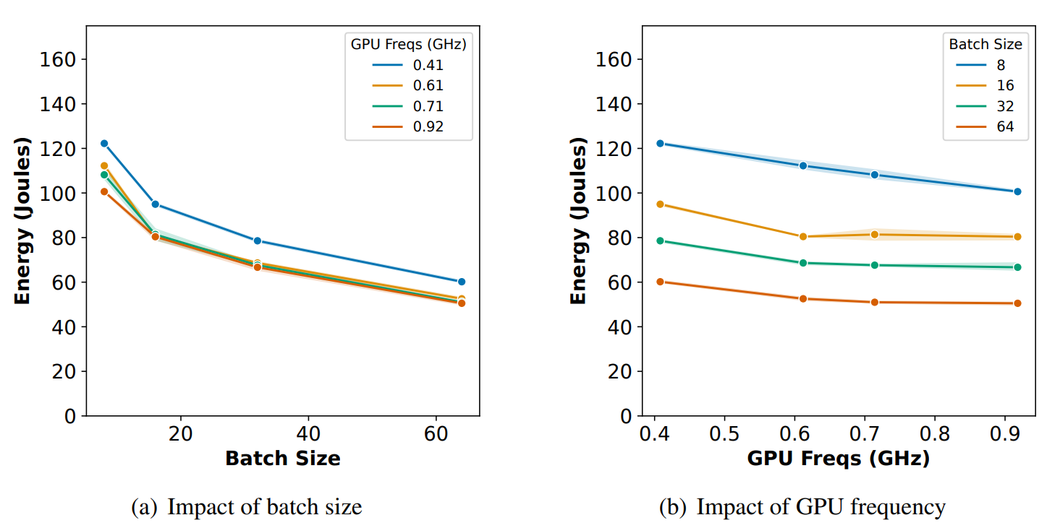
Orin– Impact of Batch Size
Energy drops almost linearly with batch size
Energy for highest batch-size is almost 35-40% lower than the lowest batch size
Energy drop at higher GPU frequencies is less pronounced due to lower I/O, memory bottlenecks
Key Takeaway:
Joint optimization of execution frequencies (CPU and GPU frequencies) batch size may yield energy savings to the tune of 19% for Orins
Notes:
Notes:
Impact of batch-size on Orins is very similar to that of Nanos and Xaviers. Energy for highest batch-size is almost 35-40% lower than the lowest batch size. Energy drop at higher GPU frequencies is less pronounced as compared to Nanos and Xaviers due to lower I/O, memory bottlenecks since Orins have higher compute capabilities. (click) Read key takeaway

Slide 60
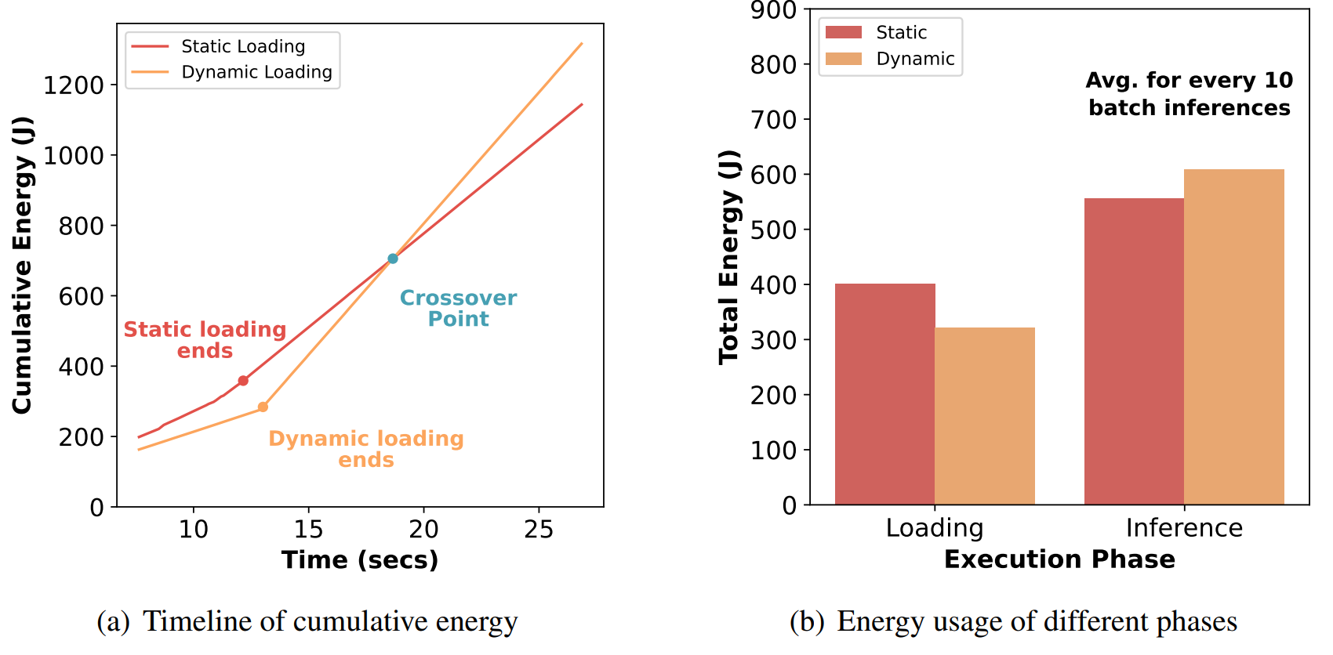
Impact of Model Initialization
DNN control flow graphs can be initialized statically or dynamically
Static Computation Graphs (eager loading) initialize the full DNN graph before execution
Dynamic Computation Graphs construct and modify the graph during runtime
Loading a static graph consumes ∼25% higher energy
Static graphs consume lower energy over time
Key Takeaway:
It is more efficient to use static-graphs for inference over long runs
Notes:
Deep Neural Network (DNN) control flow graphs, crucial for defining the network architecture, can be set up in two different ways: statically or dynamically. Static computation graphs, also known as eager loading, involve initializing the entire network architecture before any execution begins. This upfront loading tends to consume about 25% more energy initially compared to dynamic graphs. However, once loaded, static graphs become more energy-efficient over time due to their predetermined structure, which eliminates the need for building the graph during runtime.
In contrast, dynamic computation graphs are constructed and potentially altered on-the-fly during execution. This flexibility allows for changes to the graph as data flows through the network, which is particularly useful for variable input sizes and conditional operations within the network. Although dynamic graphs are less energy-intensive at initialization, their ongoing construction can lead to higher cumulative energy consumption, especially in scenarios with complex or iterative data-dependent operations.
This can be seen from the two attached plots. The right plot shows higher loading energy of static plots, but on an average static graphs consume about 8.5% less energy every 10 inferences. Thus in the left cumulative energy plot we see that over time, given a stream of continuous inference requests, there comes a crossover point after which cumulative energy for static plots starts getting lower and the lines start diverging. (click) Read takeaway

Slide 61
Impact of other factors
Comparing the implementation of DNN workloads on Python (PyTorch) vs C++ (LibTorch), Python consumes over 16% more energy
LibTorch is commonly used for DNN deployments in HPC environments
However, PyTorch is vastly popular for prototyping due to ease of use
Impact of background processes such as garbage collection and lazy loading on energy, minimal (1.82% and 1.65%)
Notes:
Discussing other factors impactingThe comparison between PyTorch and LibTorch for DNN workloads shows that Python's implementation consumes 16% more energy than C++. Despite this, PyTorch remains highly favored for prototyping due to its user-friendly nature. However libtorch is commonly used for HPC deployments given its additional energy savings. Energy cost attributed to Python's background operations like garbage collection and lazy loading is relatively small, at 1.82% and 1.65%, respectively.

Slide 62
Outline
Evaluation & Results
Background & Prior Work
Experimental Setup
Conclusion & Future Work
Notes:
Having summarized our broad results, (click)

Slide 63
Outline
Conclusion & Future Work
Background & Prior Work
Experimental Setup
Evaluation & Results
Notes:
We move on to conclusion (click)

Slide 64
Outline
Conclusion & Future Work
Background & Prior Work
Experimental Setup
Evaluation & Results
Conclusion
Future Work
Notes:
And also discuss our Future Work (click)

Slide 65
Conclusion
Optimal deployment by adjusting CPU/GPU frequencies yields upto 22% in energy savings (across all 3 devices)
Joint optimization of device (CPU & GPU frequency) and workload parameters (batch-size) may yield up to 45% in energy savings (across all 3 devices)
DVFS is almost always sub-optimal in energy-efficient deployments for DNN workloads (even with features like power capping and thermal management)
Higher batch sizes reduce overall execution energy as it decreases I/O and preprocessing
Notes:
Summarizing our results we find that: Adjusting CPU and GPU frequencies for optimal deployment can result in up to 22% energy savings. When both device frequencies and workload parameters, such as batch size, are optimized together, energy savings can increase to as much as 45%. Dynamic Voltage and Frequency Scaling (DVFS), despite features like power capping and thermal management, is usually less effective for energy-efficient DNN workload deployment. Utilizing larger batch sizes is beneficial for reducing energy consumption since it minimizes the overhead of I/O operations and preprocessing tasks.

Slide 66
Future Work
Static Optimization such as full sweeps are often impractical and time-consuming
Searching the entire CPU/GPU frequency parameter space to find the optimal or near optimal configuration, needs to be done quickly
Need to explore dynamic/online optimization approaches for real-world deployment
Notes:
Static Optimization such as full sweeps are often impractical and time-consuming. Especially given the time-sensitive nature of inference requests Searching the entire CPU/GPU frequency parameter space to find the optimal or near optimal configuration, needs to be done quickly. As such, for our future work we need to explore dynamic/online optimization approaches for real-world deployment

Slide 67
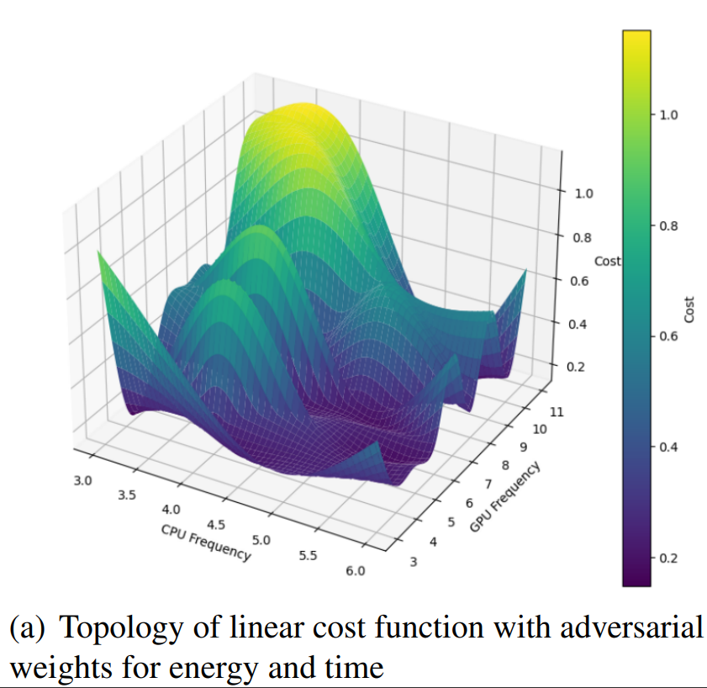
Future Work
Even linear function with adversarial weights on energy and inference latency presents a challenging landscape for online optimization
We are currently exploring multiple Multi-Armed Bandit based approaches for online gradient descent:
Thomson Sampling
Online descent
Notes:
However, this is not a trivial problem to solve. Even the topology of a linear cost function with adversarial weights on energy and inference latency, setup to obtain a pareto front, presents a challenging landscape for online optimization. We are currently exploring multiple Multi-Armed Bandit based approaches for online gradient descent such as for dynamic optimization of the optimal configuration problem.
Thomson Sampling
Online descent

Slide 68
Thank you! Questions?
Nov 10 | RPE Presentation

Slide 69
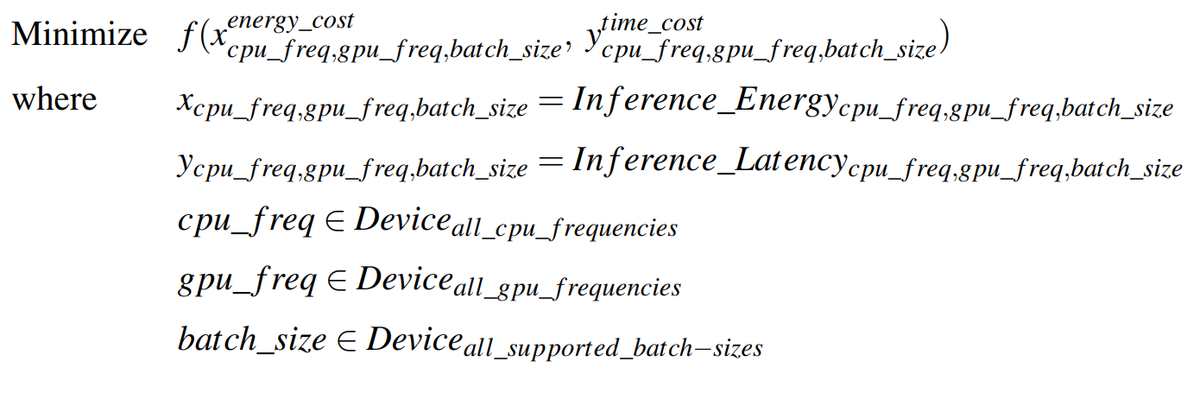
Conclusion & Future Work
Static Optimization approaches (including full sweeps) are often impractical and time-consuming
Need to explore dynamic/online optimization approaches for real-world deployment
Notes:
Add a problem statement (algorithm that picks up the near optimal)

Slide 70
DVFS Baselines
DVFS is a set of predefined heuristics in OS that allows the system to dynamically adjust the voltage and frequency levels of the CPU and GPU, during runtime, based on workload demands
Common DVFS governor policies for optimizing CPU performance are:
Performance
Powersave
Ondemand
Conservative
Schedutil
Common DVFS governor policies for optimizing GPU performance (for NVIDIA GPUs) are:
‘nvhost_podgov’
‘wmark_active’
Baselines for all our energy measurements are based on DVFS (‘Schedutil’, ‘nvhost_podgov’) energy values for the DNN workload
Notes:
Move this to background

Slide 71
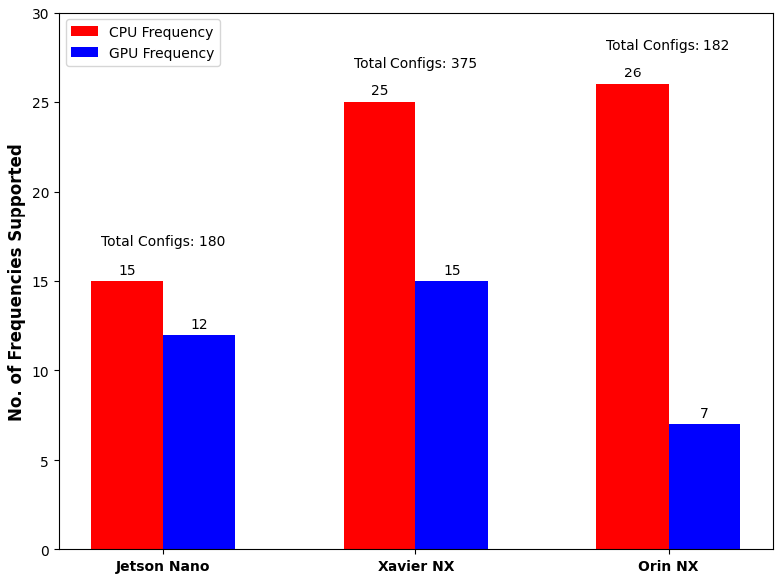
Challenges of energy-optimal DNN deployments on edge
Naively adjusting operating CPU/GPU frequency may be sub-optimal
Large parameter space in terms of operating CPU/GPU frequency
Each DNN architecture needs to be studied separately due to varying complexity
Notes:
One knob we consider is freq.
CPU GPU frequency can be adjusted but at the cost of power or latency
Replace graph with table
Try to keep slide title location and format consistent across slides.
"needs to be studied separately"
5 bullets is a bit much for opening slides. You do not need to do death-by-information to get your point across. Keep it to few, prominent points.

Slide 72
Edge Deployment Environment
Hardware (device) Parameters impact the power usage and inference time (thus impacting energy)
Workload Parameters impact the power usage and inference time (thus impacting energy)
Most deployments rely on DVFS to manage these execution parameters
Goal – Verify if DVFS is optimal in minimizing total energy of the inference workload
Comparison of inference latency and power consumed under different CPU/GPU frequencies when running AlexNet on Jetson Nano
Notes:
Not sure we want to show results upfront. This is not a paper as such. Again, please see Deb's flow in his RPE.

Slide 73
Other Orthogonal Works
Additional works (Lee et. al, Han et. al, Park et. al etc.) primarily focus on algorithmic and architectural optimizations rather than direct energy optimization
Methods like the dynamic sub-network strategy in SubFlow (Lee et. al), runtime architecture switching (Lou et. al), and block-grained scaling (Han et. al ) aim to enhance performance and inference efficiency on edge devices
While these innovations invariably lead to improved energy efficiency as a secondary benefit, they do not explicitly focus on energy optimization
Key Takeaway:
There is distinct gap in the current research landscape specifically targeting energy optimization of DNN inference by tuning device and workload parameters
Notes:
Can/should be skipped. You can put this in backup slides.

Slide 74
Edge-Device Specifications
Specification | Jetson Nano | Jetson Xavier NX | Jetson Orin NX
CPU | 4-core ARM A57 | 8-core Nvidia Carmel | 8-core Nvidia Cortex
CPU Freq. range | 102 MHz – 1.48 GHz | 115 MHz – 1.9 GHz | 115 MHz – 2.0 GHz
CPU Freq. step | 100 MHz (15 steps) | 77 MHz (25 steps) | 77 MHz (26 steps)
GPU | Nvidia Maxwell | NVIDIA Volta | NVIDIA Ampere
CUDA Cores | 128 | 384 | 1024
Tensor Cores | - | 48 | 32
Memory | 4 GB LPDDR4 | 8 GB LPDDR4 | 16GB LPDDR5
GPU Freq. range | 76 MHz – 921 MHz | 114 MHz – 1.1 GHz | 308 MHz – 918 MHz
GPU Freq. steps | 77 MHz (steps 12) | 90 MHz (steps 15) | 102 MHz (7 steps)
Throughput | 0.472 TOPs | 21 TOPs | 100 TOPs
Notes:
Highlight throughput Change Throughput unit to uniform TOPs

Slide 75
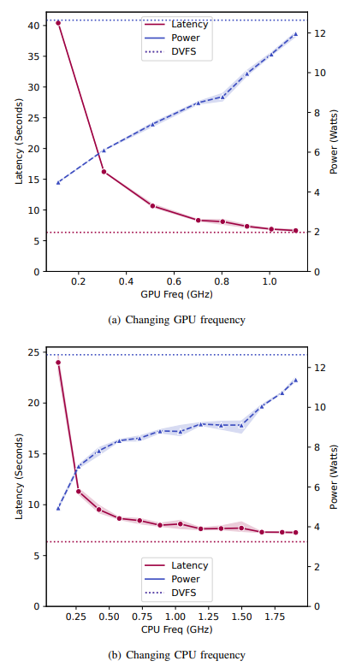
Xavier– Frequency Scaling Sweep
DVFS operates at the highest CPU frequency for 87% and at highest GPU frequency for 79% of the total execution
Difference in energy consumption is within 2% of default (including ‘Powersave’ which consumes ~1.3% less)
Trends remain similar to Nano
Key Takeaway:
The NVIDIA Jetson Xavier NX demonstrates faster inference and higher power consumption than the Jetson Nano, with a significant difference in power span
Comparison of inference latency and power consumed under different CPU/GPU frequencies when running AlexNet on Xavier NX.
Notes:
Mention the plateau effect remove all captions Explain the figures Animate the key takeaway Figure sizes should increase

Slide 76
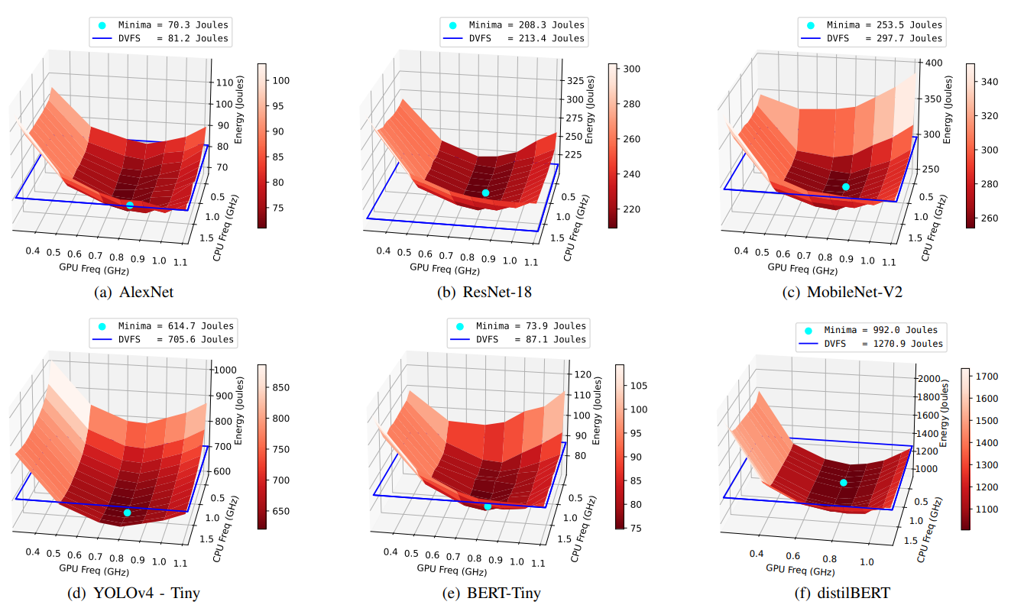
Xavier– Energy Topology
Key Takeaway:
The non-monotonicity of energy topology is even more apparent in Xaviers demonstrating that the problem of finding an optimal CPU-GPU energy configuration is not trivial
Notes:
Explain each plot

Slide 77
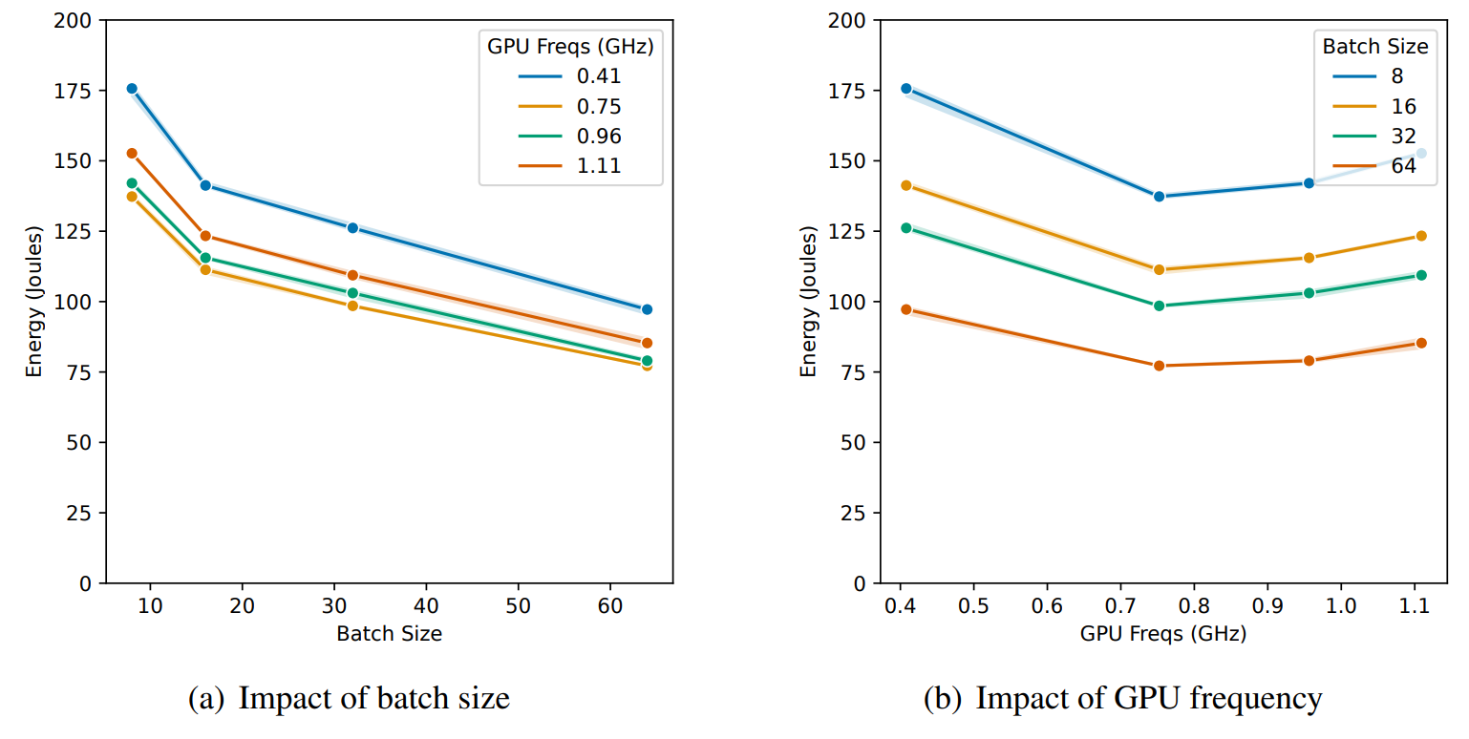
Xavier– Impact of Batch Size
Energy drops almost linearly with batch size
Energy for highest batch-size is almost 35-42% lower than the lowest batch size
Drop is less pronounced at higher batch sizes similar to Nanos
Comparison of energy consumed for different batch sizes and GPU/CPU frequencies when running AlexNet inference on Xavier NX
Key Takeaway:
Joint optimization of execution frequencies (CPU and GPU frequencies) and batch size may yield energy savings to the tune of 35 - 45% for both Jetson Nanos and Xaviers
Notes:
Mention the plateau effect

Slide 78
Outline
Evaluation & Results
Background & Prior Work
Experimental Setup
Conclusion & Future Work
Notes:
Changelogs:
Added a new research goals slide

Slide 79
Outline
Background and Prior Work
Experimental Setup
Evaluation and Results
Conclusion and Future Work

Slide 80
Outline
Background and Prior Work
Experimental Setup
Evaluation and Results
Conclusion and Future Work

Slide 81
Outline
Background and Prior Work
Experimental Setup
Evaluation and Results
Conclusion and Future Work

Slide 82
Outline
Background and Prior Work
Experimental Setup
Evaluation and Results
Conclusion and Future Work

Slide 83
Outline
Background and Prior Work
Experimental Setup
Evaluation and Results
Conclusion and Future Work
Jetson Nano – Frequency Sweep, Energy Topology, Impact of Batch Size
Xavier NX – Frequency Sweep, Energy Topology, Impact of Batch Size
Orin NX – Frequency Sweep, Energy Topology, Impact of Batch Size
Impact of Computational Graph Initialization & Other Factors
Notes:
Remove white/red contrast for subsections Left box reduce text (Reduce to Nano, Orin, Computation Graph)

Slide 84
Outline
Background and Prior Work
Experimental Setup
Evaluation and Results
Conclusion and Future Work

Slide 85
Outline
Background and Prior Work
Experimental Setup
Evaluation and Results
Conclusion and Future Work

Slide 86
Outline
Background and Prior Work
Experimental Setup
Evaluation and Results
Conclusion and Future Work
Experimental Setup
DNN Workloads
Hardware Knobs
DVFS Baselines

Slide 87
Outline
Background and Prior Work
Experimental Setup
Evaluation and Results
Conclusion and Future Work

Slide 88
Outline
Background and Prior Work
Experimental Setup
Evaluation and Results
Conclusion and Future Work
Device Specifications
Studies on Energy Consumption for DNN Inference
Studies on Energy Consumption for DNN Training
Studies on Power and Performance
Notes:
Too much text again :)
For each bullet in outline, like BG & PW, add at most 2-3 sub-bullets. Also, maybe switch left and right panes? Create a separate slide for prior work and discuss what kind of prior work we are discussing and omitting

Slide 89
(3) Prior Work on Power/Performance for DNN Inference
DeepEdgeBench - Baller et al.
Investigates power consumption of MobileNet-V2 on multiple edge devices (Nano, Coral Dev Board, Tinker Edge etc.)
Work does not include optimization of hardware and model parameters for enhancing energy efficiency
Süzen et al.
Provides performance comparison of single-board computers (Nano, TX2, Raspberry Pi) for CNNs on accuracy, inference time, memory, and power consumption
Although, energy measurements are reported,impact of CPU/GPU frequency and workload-specific parameters not analysed
Notes:
Notes:
Moving to works studying Power/Performance for DNN Inference - DeepEdgeBench studies the power consumption of MobileNet-V2 across various edge devices, without optimizing hardware or model parameters for energy efficiency. Süzen et al. compare the performance of single-board computers like the Nano, TX2, and Raspberry Pi for CNNs, focusing on accuracy, inference time, memory, and power consumption, but do not explore the influence of CPU/GPU frequency or other specific workload parameters on energy usage. While both works report energy measurements, the focus of work is not energy-efficient deployments rather focusing and power/accuracy tradeoffs

Slide 90
(3) Prior Work on Power/Performance for DNN Inference
Study | Research Focus | Workload | Energy Optimization Strategies Proposed
Baller et. al | Power | MobileNet-V2 | No (Energy values reported)
Süzen et. al | Accuracy, Latency, Memory, & Power | Multiple-CNNs | No (Energy values reported)
Our work | Energy | 6 DNN models across 3 use-cases | Yes
Notes:
Notes:
Summarizing all the prior works investigating power and performance on DNN inference deployments on edge (click)
Comments:
May be best to only list and only discuss works that focus at least on power/energy and ignore the rest entirely

Slide 91
(3) Prior Work on Power/Performance for DNN Inference
Study | Research Focus | Workload | Energy Optimization Strategies Proposed
Baller et. al | Power | MobileNet-V2 | No (Energy values reported)
Süzen et. al | Accuracy, Latency, Memory, & Power | Multiple-CNNs | No (Energy values reported)
Our work | Energy | 6 DNN models across 3 use-cases | Yes
Notes:
Notes:
Our work primarily focuses on optimal DNN inference deployments on edge with emphasis on energy vis-a-vis power, performance or accuracy.

